Slide 1

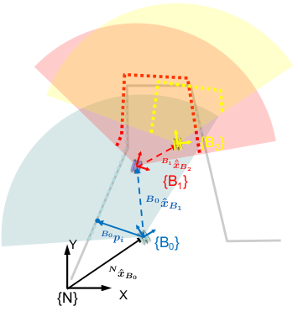
Hands On Localization
Posed Based EKF SLAM (PEKF-SLAM) Using ICP laser scans matching
Team Members:
Pravin Oli
Gebrecherkos G.
Supervisors:
Prof. Pedro Ridao Rodriguez
Roger Pi Roig
1

Slide 2
CONTENTS
Introduction
Problem Statement
System Overview
State Representation
Motion Model
Scan Acquisition
New Pose Addition
IMU (Heading Correction)
ICP Based Scan Match
ICP Trade-Off
11. Data Association
12. Observation Model
13. EKF Update
14. Mapping and Visualization
15. Simulation
16. Experiment & Result
16. Conclusion
2

Slide 3
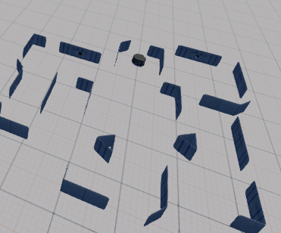
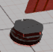

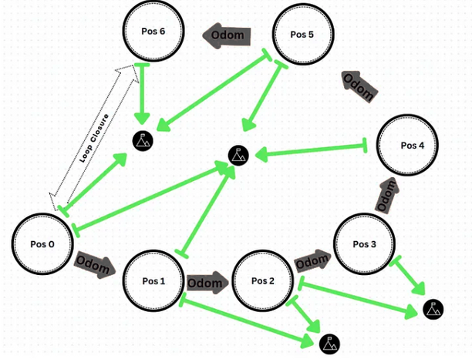
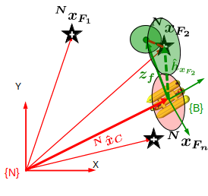
1. Introduction-SLAM
“Where am I?”
“What does the world around me look like?”
“Can I figure both out at the same time?
SLAM — Simultaneous Localization and Mapping
Feature EKF SLAM
Pose EKF SLAM
Graph SLAM
3

Slide 4
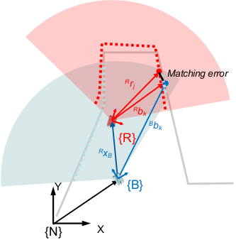
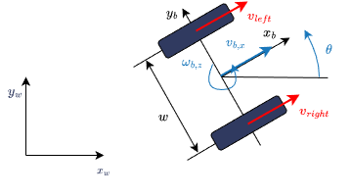
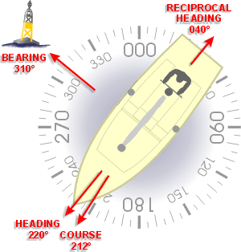
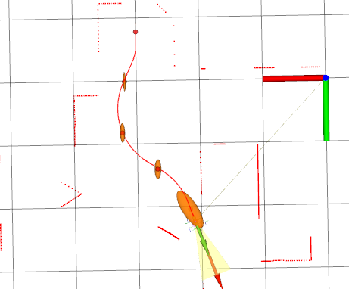
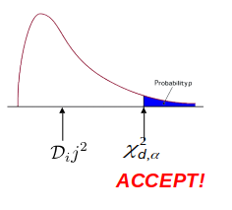
2. Problem Statement
A Full SLAM Pipeline using:
Motion Model : Odometry
2. Measurement Model: Compass (heading)
3. Observation Model: ICP (relative pose)
4. Estimation Method: EKF (Pose-Based)
4
5. Data Association: ICNN

Slide 5
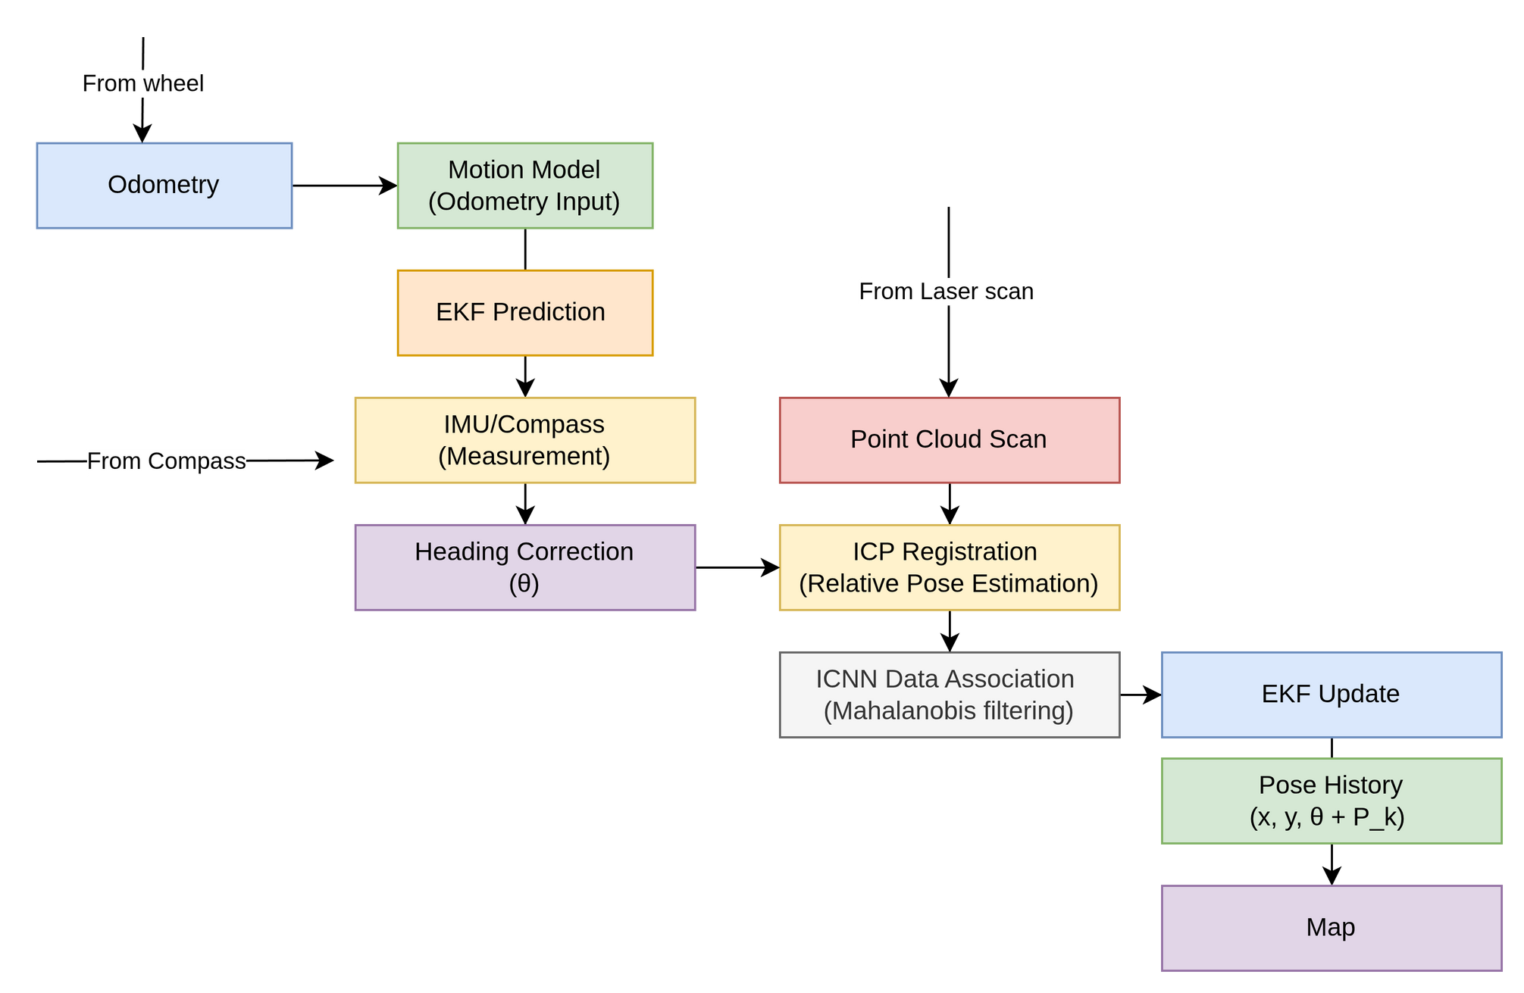
3. System Overview
5

Slide 6
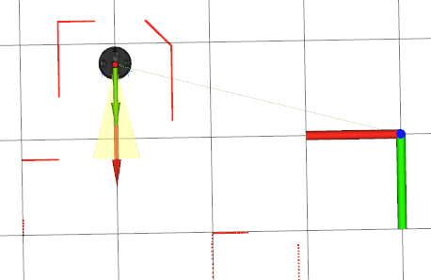
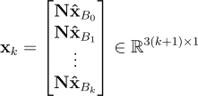
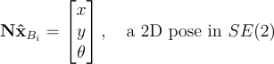
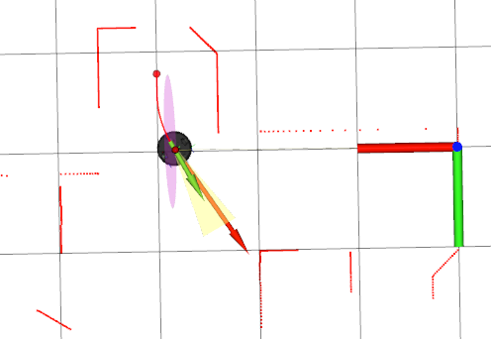
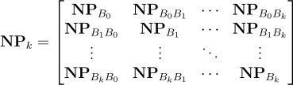
4. State Representation
1. State Vector: Nˆxk (Global frame {N }):
2. Covariance Matrix: NPk
Pose covariances, Cross-covariances
6

Slide 7
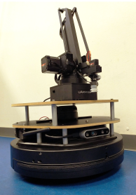
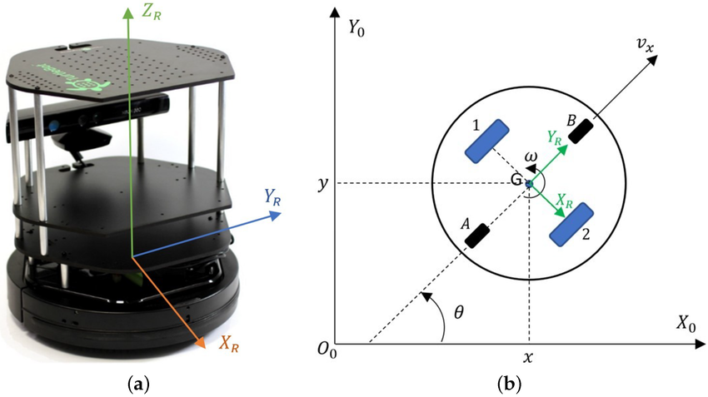
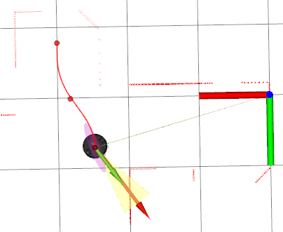
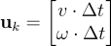
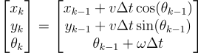
5. Motion Model
7

Slide 8
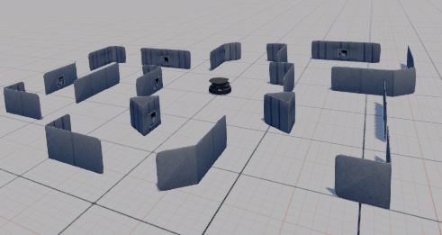
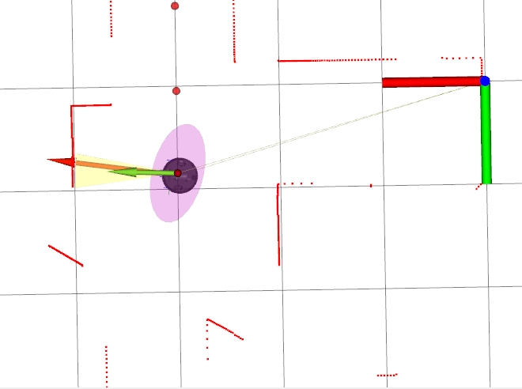
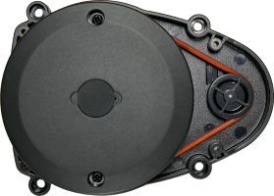
6. Scan Acquisition
Lidar
Map Representation: M
8

Slide 9
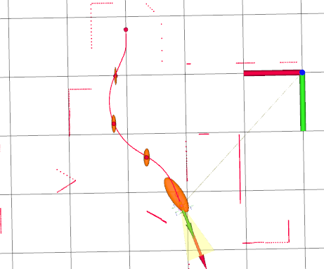
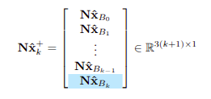
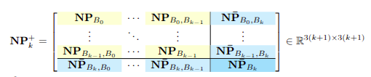
7. New Pose Addition
1. State vector Expansion
2. Covariance Matrix Expansion
9

Slide 10
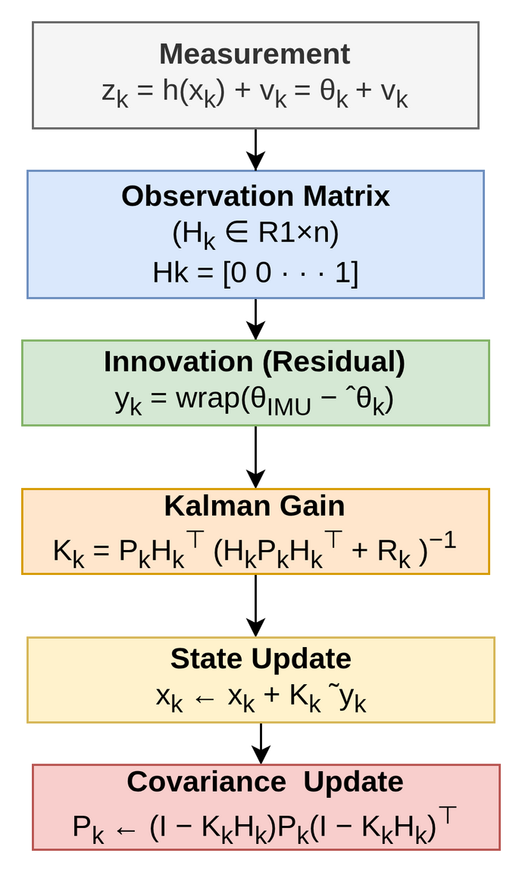
8. IMU Heading Correction
ˆθ — predicted heading from the state xk
vk ∼ N (0, Rk) — additive zero-mean Gaussian noise from the IMU
θIMU — measured yaw angle from the IMU
Hk — observation matrix
Rk — measurement noise covariance
Pk — current pose covariance
10

Slide 11
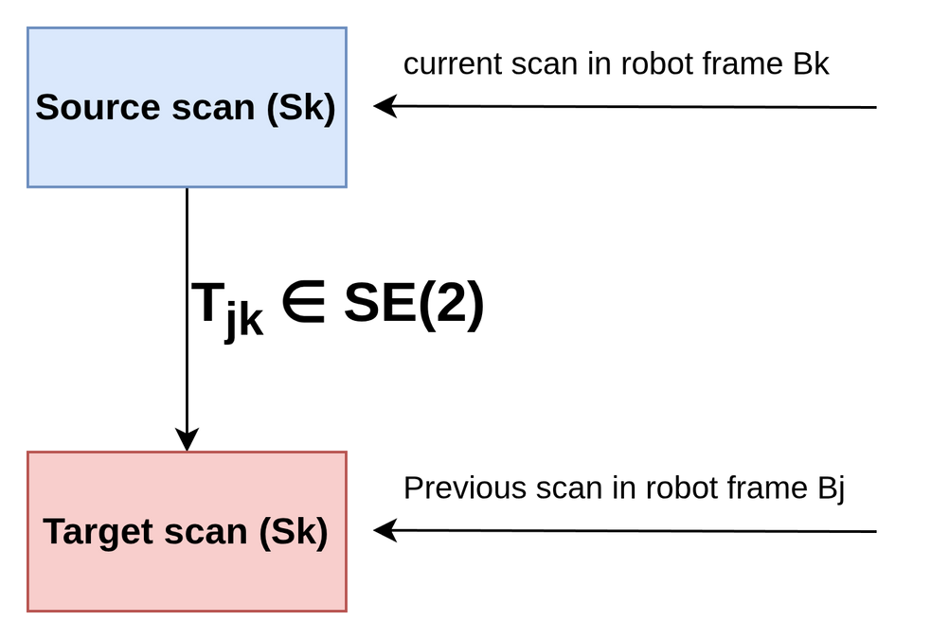
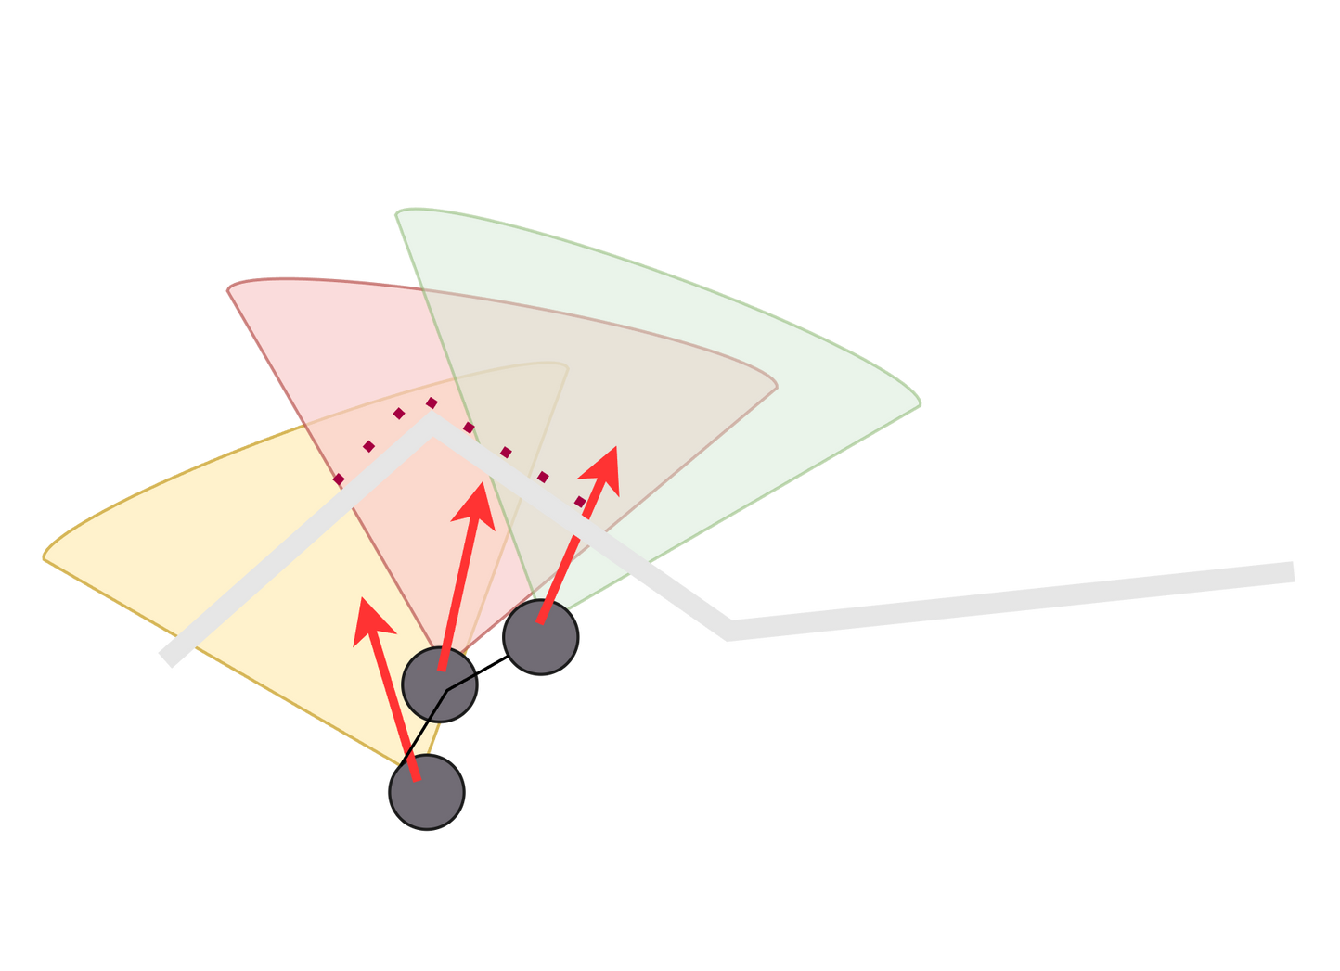
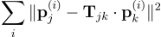
9. ICP Scan Match
ICP (Iterative Closest Point)
Aligning (2D or 3D) point clouds by estimating the rigid transformations.
Goal: Find the transformation Tjk​ that minimizes this total squared distance:
11

Slide 12
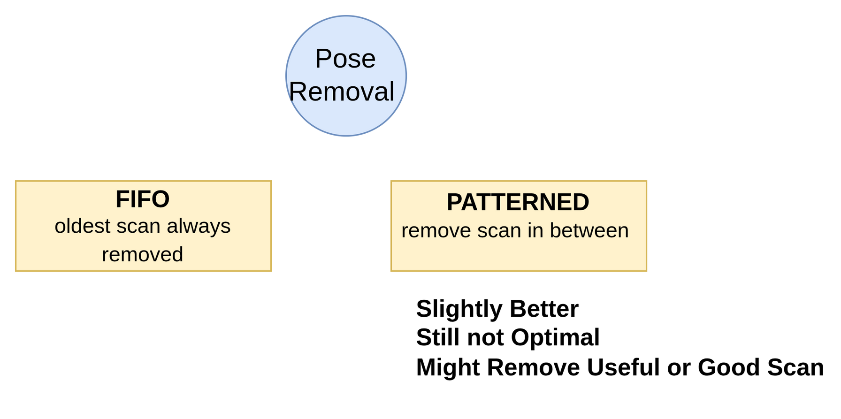
10. ICP Trade-OFF
12

Slide 13
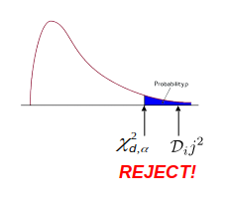
11. Data Association
Strategy: ICNN (Individual Compatibility Nearest Neighbour)
Tool : Mahalanobis Distance
Test: Chi Square Test
α is the confidence level (e.g., 0.95)
dof = degrees of freedom (3 for 2D pose)
13

Slide 14
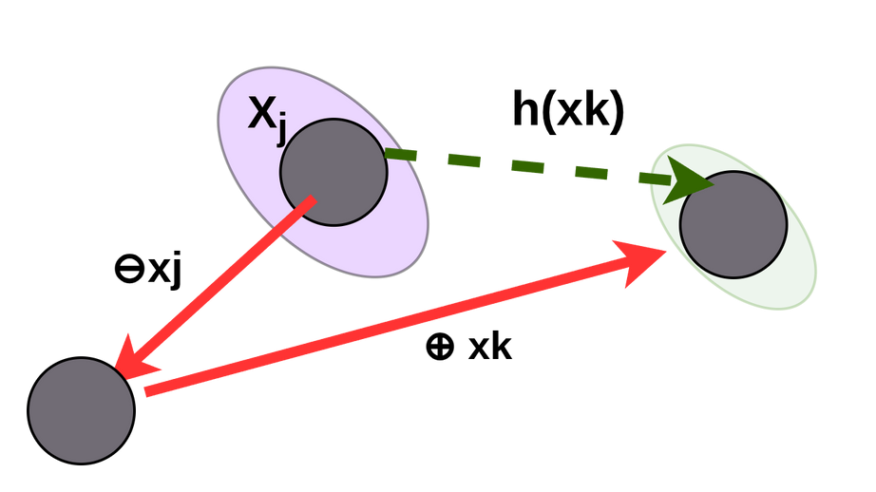
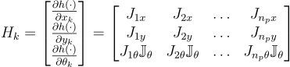
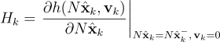
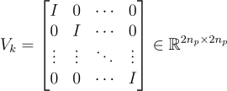
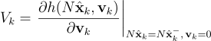
12. Observation Jacobian
Relative pose prediction
Observation Jacobian with Respect to Pose
Observation Jacobian with Respect to Noise
14

Slide 15
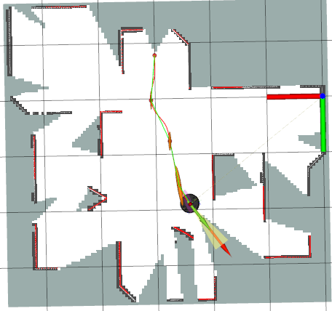
13. EKF Update
Residual (Innovation)
Kalman Gain
State Update
Covariance Update
15

Slide 16
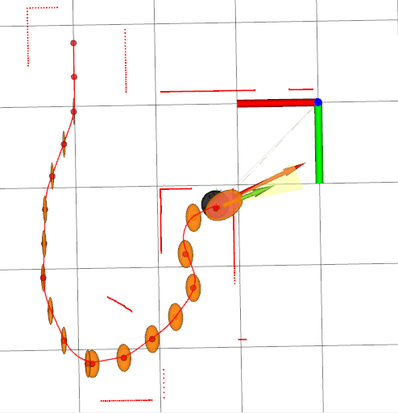
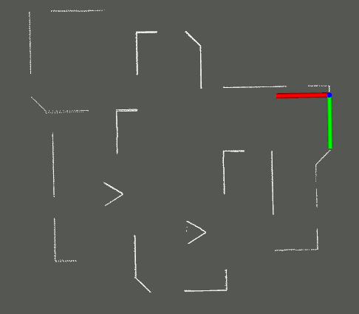
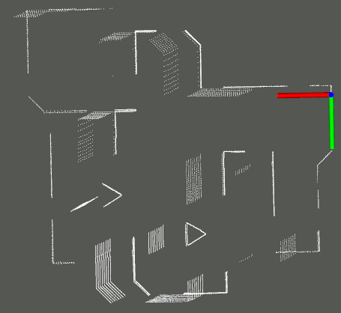
14. Mapping & Visualization
Perfectly Aligned Scans
Mis- Aligned Scans
16

Slide 17
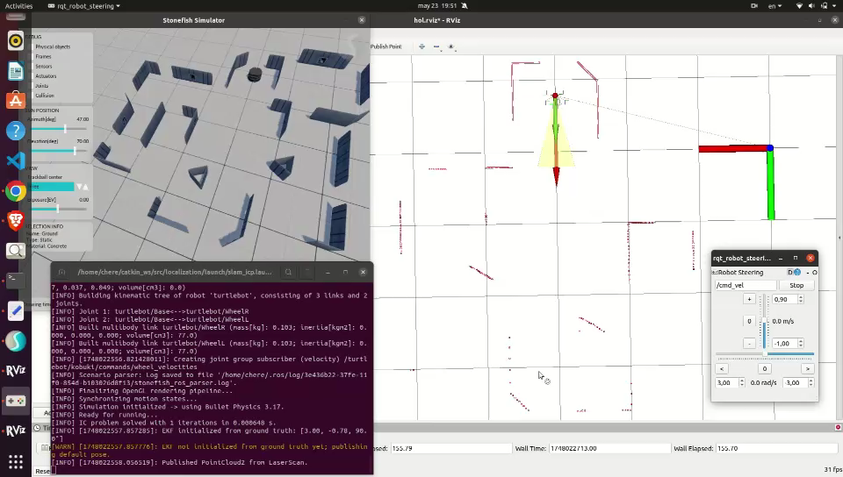
15. Simulation
17

Slide 18
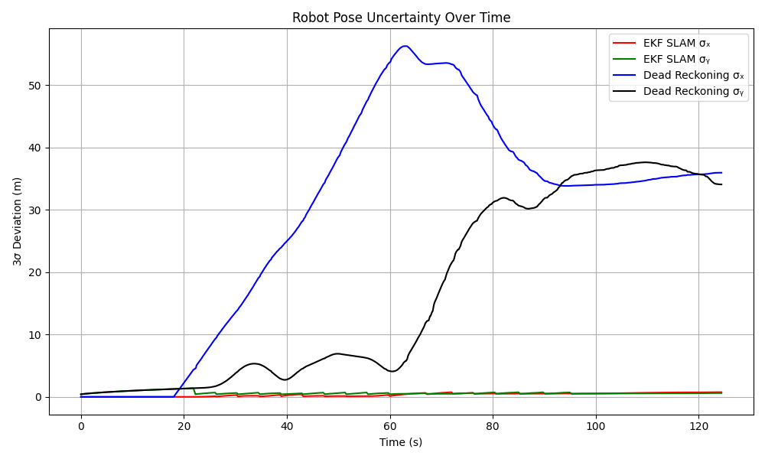
16. Experiment & Result
ICP slam Vs DR IMU (3 sigma uncertainity)
18

Slide 19
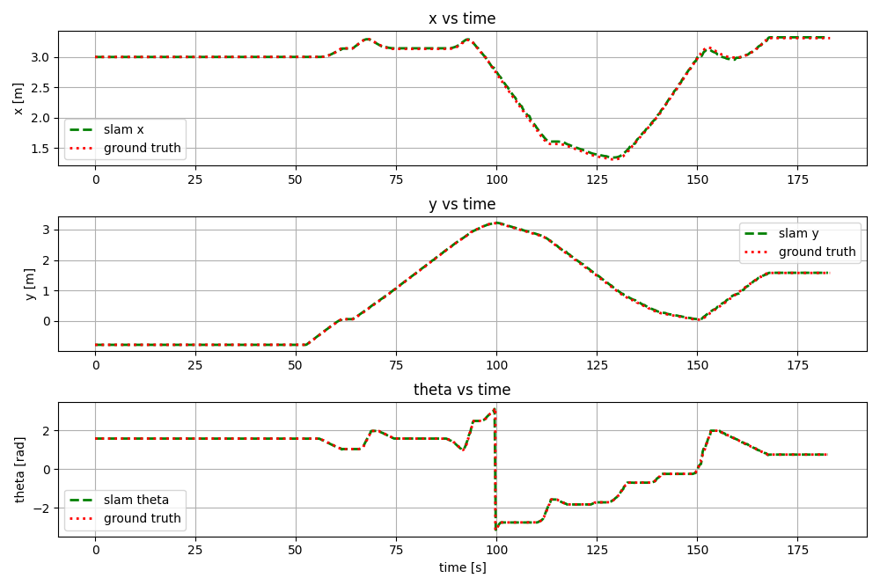
16. Experiment & Result
ICP slam Vs DR IMU (x, y, Theta)
19

Slide 20
17. Conclusion
PEKF SLAM system clearly outperforms dead reckoning.
Compensates for odometry drift through IMU corrections and scan registration.
Maintains a global map and pose history.
ICNN filters out bad scan matches, improving robustness.
Trustworthy SLAM in Noisy and Featureless Environment.
20

Slide 21
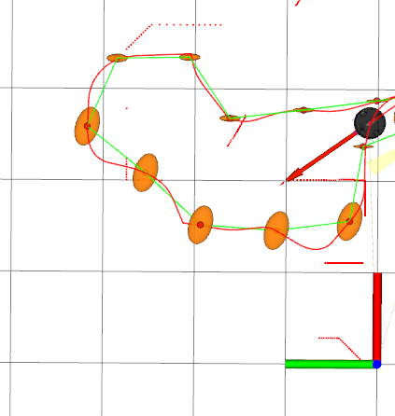
Thank You
Q & A
21

